Slide 1
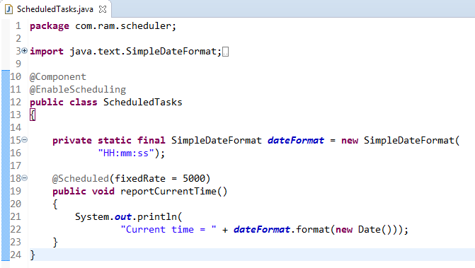
Schedule a Task at a Fixed Rate [Configuring scheduled tasks using Annotation]
@EnableScheduling ensures that a background task executor is created. Without it, nothing gets scheduled.
The Scheduled annotation defines when a particular method runs.
NOTE: This example uses fixedRate, which specifies the interval between method invocations measured from the start time of each invocation.
Note that the beginning of the task execution doesn’t wait for the completion of the previous execution.This option should be used when each execution of the task is independent.
The simple rules that need to be followed to annotate a method with @Scheduled are:
a method should have void return type
a method should not accept any parameters
@Scheduled(fixedRateString = "${fixedRate.in.milliseconds}")
Hardcoding these schedules is simple, but usually, you need to be able to control the schedule without re-compiling and re-deploying the entire app.
We’ll make use of Spring Expressions to externalize the configuration of the tasks – and we’ll store these in properties files:

Slide 2
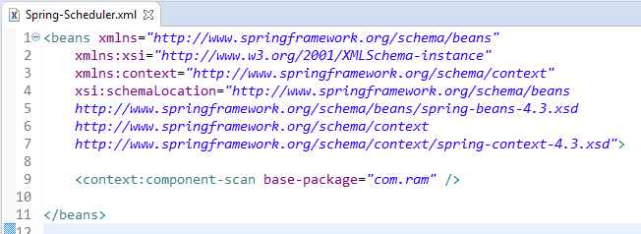
Schedule a Task at a Fixed Rate [Configuring scheduled tasks using Annotation]

Slide 3
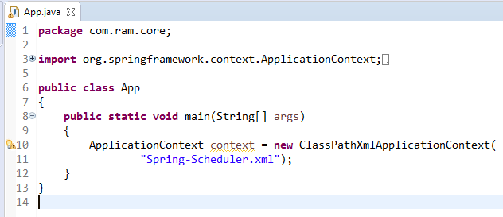
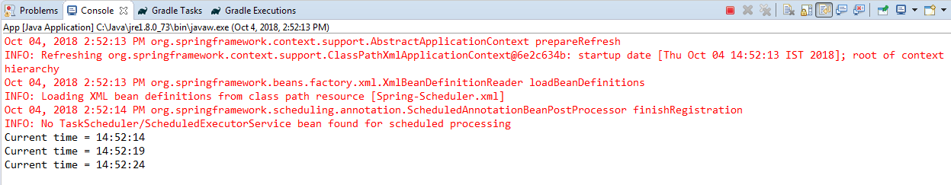
Schedule a Task at a Fixed Rate [Configuring scheduled tasks using Annotation]

